Slide 1
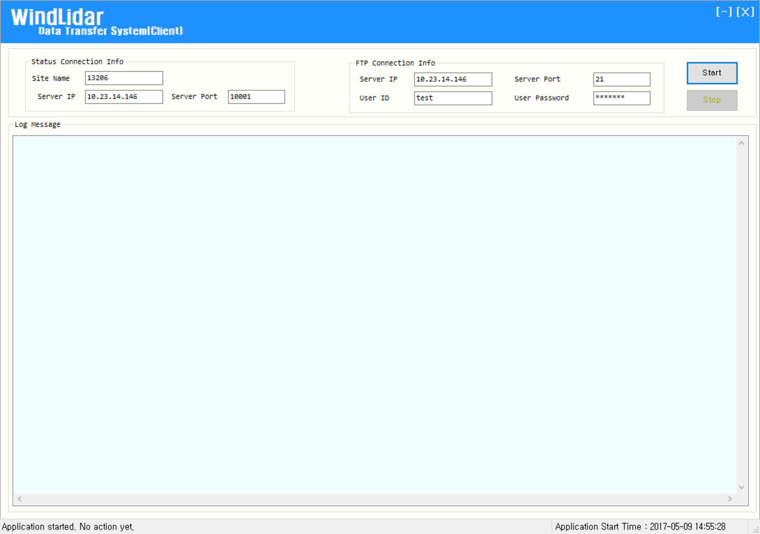
⑤
①
②
④
③

Slide 2
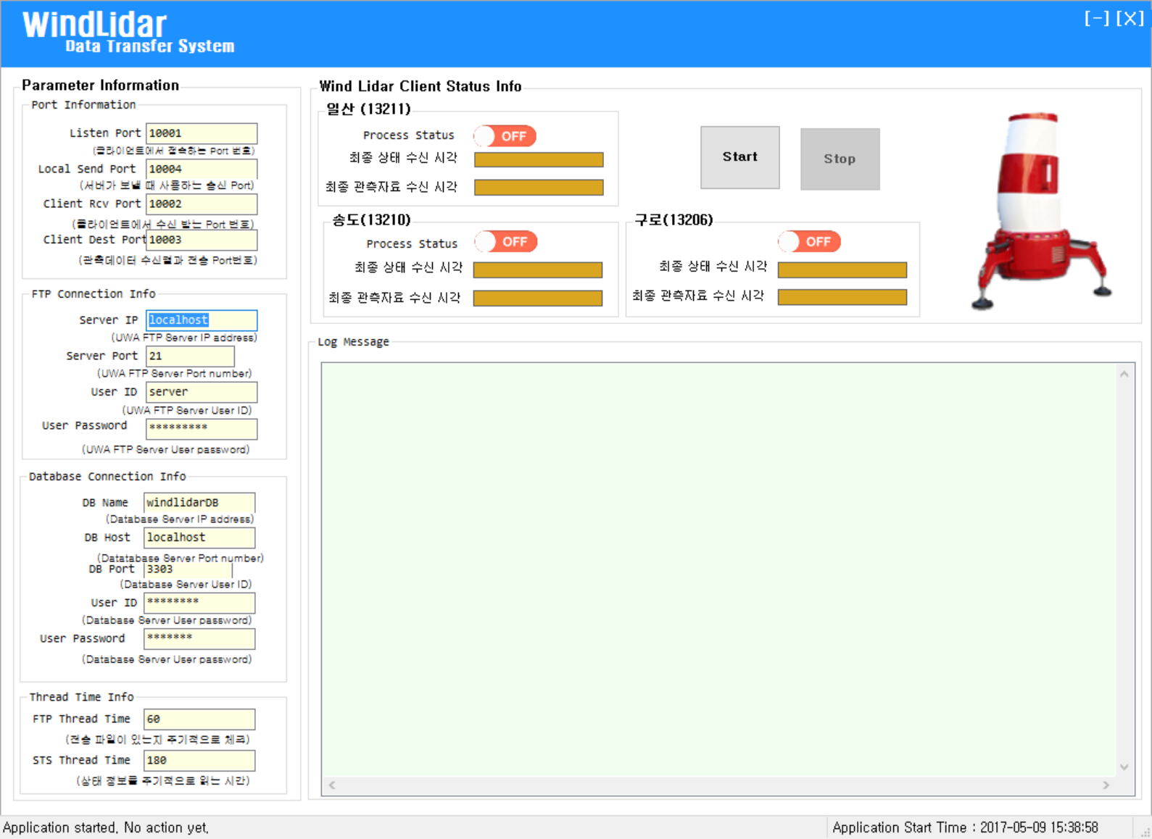
⑦
①
⑥
⑤
⑤
②
⑧
③
④

